Slide 1




TELECOM COMPANY
CUSTOMER CHURN
ANALYSIS
PRESENTED BY : SHUBHAM SONI

Slide 2
OBJECTIVE OF ANALYSIS
To understand the key factors driving customer churn.
To identify patterns and trends in customer behaviour.
To provide actionable insights to reduce churn and improve customer retention.

Slide 3
DATASET OVERVIEW
Total Records and Features:
The dataset contains 7,043 records and 33 columns.
It includes both numerical and categorical variables.
Data Completeness:
All columns except Churn Reason and Total Charges are fully populated.
The Churn Reason column has 1,869 non-null values, representing about 26.5% of the dataset.
Key Variables:
Customer Information: Includes CustomerID, Gender, Senior Citizen, Partner, Dependents, and location details (Country, State, City, Zip Code).
Types of services: Phone Service, Internet Service, Streaming TV, Streaming Movies, etc.
Contract details: Contract, Paperless Billing, and Payment Method.
Billing Details:
Monthly Charges: Range from $18.25 to $118.75 (mean: $64.76, standard deviation: $30.09).
Total Charges: Contains inconsistent data, requiring preprocessing to handle as numeric.

Slide 4
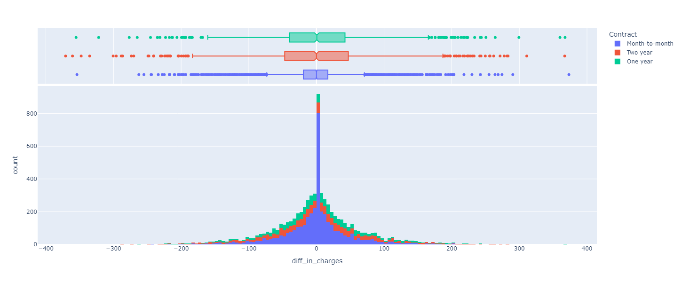
DATA CLEANING AND PREPARATION
Converted Total Charges to numeric for accurate calculations.
Handled missing values using:
Used (monthly charges)*(tenure) as total charges to fill the missing values.
Most of the values for diff_in_charges are centered around 0, indicating that for the majority of entries, the calculated total charges closely match the recorded total charges.

Slide 5
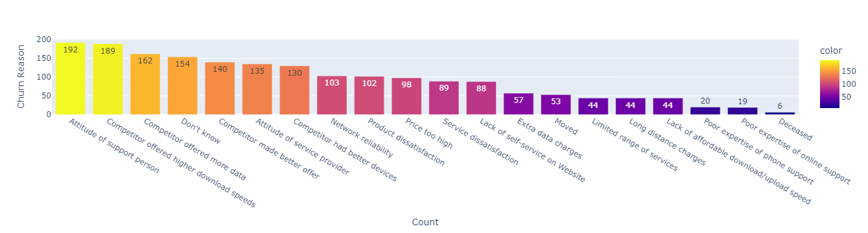
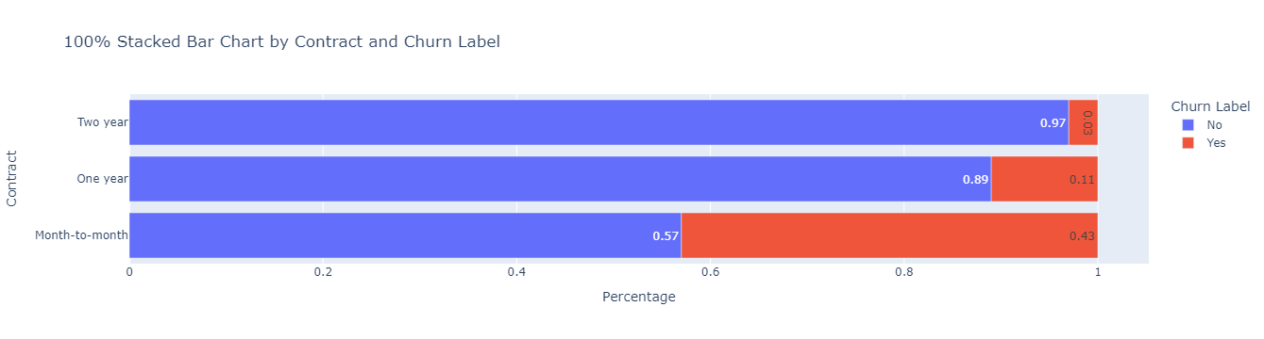
KEY INSIGHTS FROM EDA
Reasons for customers leaving the company:
Churn rate is 43% for month-to-month contracts, 11% for one-year contracts, and 3% for two-year contracts.

Slide 6
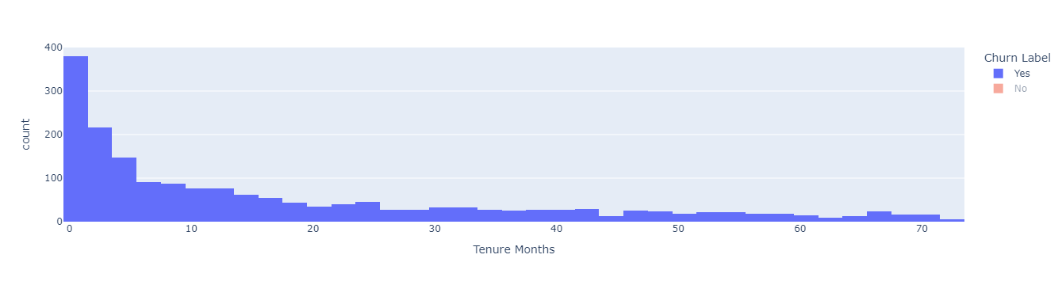
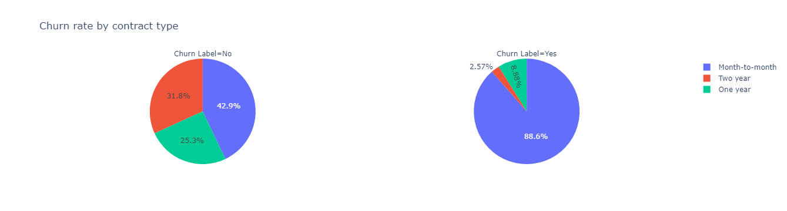
The number of clients in the churn ceases to decline by 61% after 5 months in the service.
88.7% of customers who left the service had a Month-to-month contract type and only 2.57% of customers who left the service had a two-year contract

Slide 7
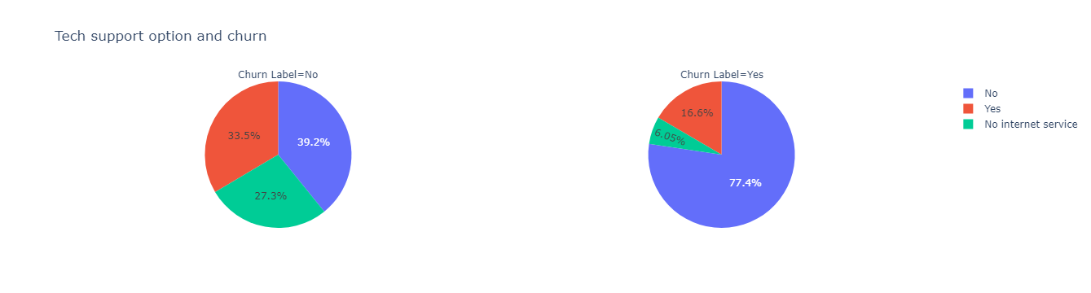
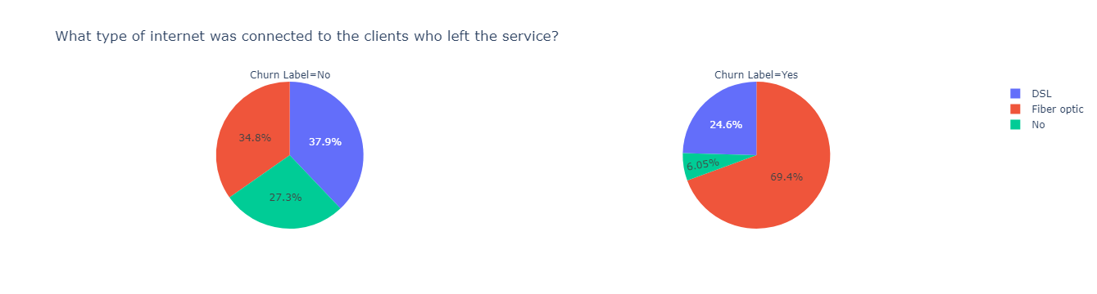
77.4% of the customers who left the service did not have the tech support option enabled.
69 percent of those who left the service were connected to the fiber optic Internet.

Slide 8
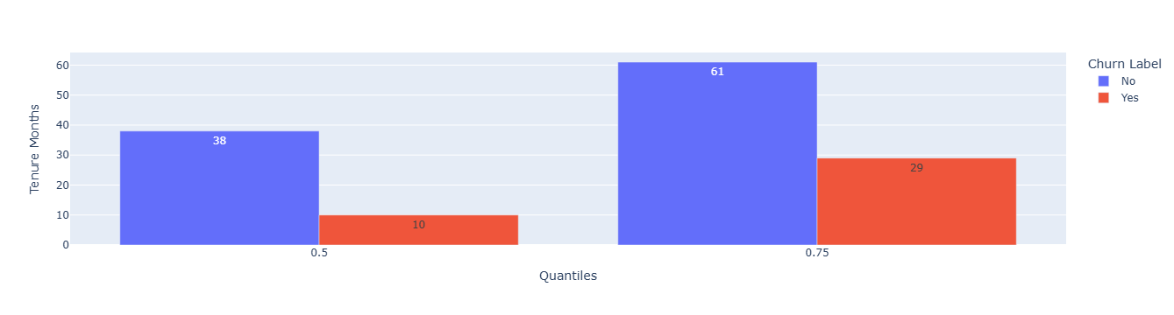
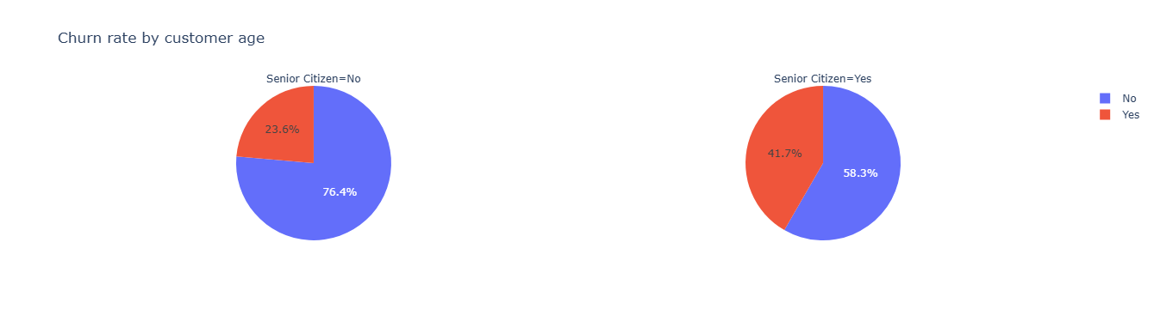
50% of customers churned within the first 10 months.
The churn rate among senior citizens is almost twice as high as among non-senior citizens. However, there are also much fewer such customers.

Slide 9
WHAT WE DISCOVERED
Customer Churn Overview:
Churn Rate: 26.5% of customers have stopped using the company's services.
Timing of Churn:
50% of customers churned within the first 10 months.
Churn declines significantly (by 61%) after 5 months of service.
Demographic Analysis:
All customers are from the USA, primarily California.
Cities with the highest customer counts:
Los Angeles: 305 customers & San Diego: 150 customers.
Gender: No significant relationship between gender and churn.
Contract Type:
Month-to-month contracts have the highest churn rate (43%):
88.7% of churned customers were on month-to-month contracts.
Churn rate decreases significantly for one-year (11%) and two-year (3%) contracts.

Slide 10
WHAT WE DISCOVERED
Internet Service:
Customers with optical fiber Internet have the highest churn rate (42%).
Clients without internet service have the lowest churn rate (7%).
Payment Method:
Among customers with optical fiber Internet, most use electronic receipts as a payment method.
Tech Support:
77.4% of churned customers did not have the tech support option enabled.
Churn Reasons:
Divided into two categories:
Internal: Product/service quality, pricing issues.
External: Competitor offerings, network reliability.

Slide 11
STRATEGIES TO REDUCE CHURN
Promote Long-Term Contracts: Offer discounts and perks for one-year and two-year contracts.
Enhance Onboarding: Focus on customer retention within the first 10 months through follow-ups and resources.
Improve Fiber Internet: Address performance issues and offer guarantees for fiber Internet users.
Promote Tech Support: Bundle tech support with plans and provide free trials for new customers.
Personalized Retention Offers: Target high-risk customers with tailored discounts and rewards.
Address Internal Churn Reasons: Conduct surveys and resolve dissatisfaction with services or pricing.
Analyze Competitor Trends: Stay competitive in pricing and network reliability to reduce external churn.

Slide 12
CONCLUSION
Analysis reveals clear patterns and factors driving churn.
Strategic interventions can improve customer retention and revenue.
Continuous monitoring of churn metrics is essential for sustained growth.

Slide 13
THANK YOU

